Slide 1

Construct Training/Test Sets for Model Evaluation: cross-validation
Professor Bo Liu
James Watt School of Engineering

Slide 2
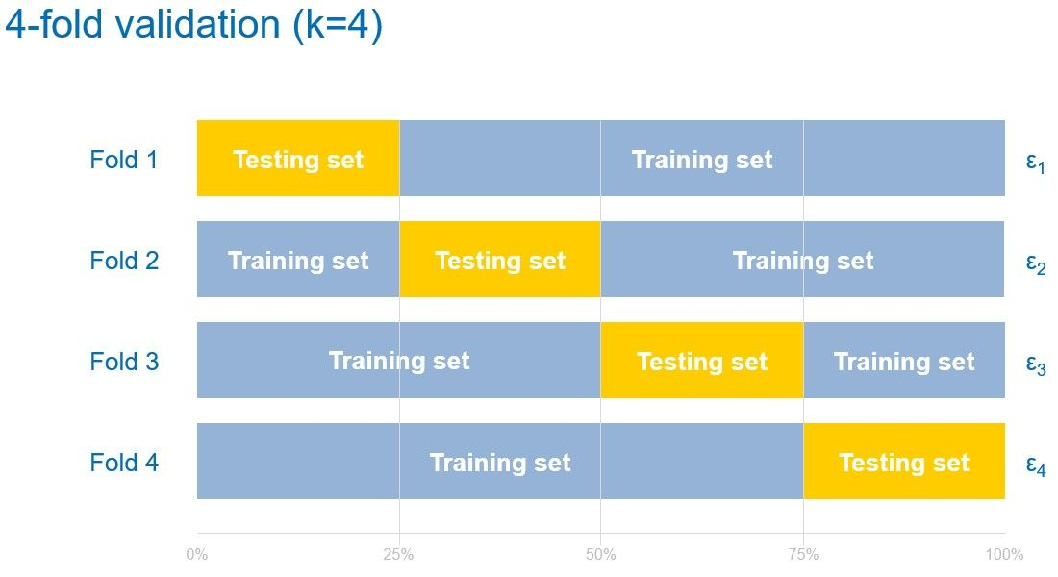
K-fold cross validation
Dataset is divided into multiple subsets or "folds."
The model is trained on a combination of these (k-1) folds and tested on the remaining one.
Cycling through each fold as a test set.

Slide 3
K-fold cross validation
Pros
Reduced random error of splitting.
Robust performance evaluation.
Maximized dataset utilization.
Cons
Longer training time.
Increased complexity in implementation.

Slide 4
Implementation
hpartition = cvpartition(group, 'KFold’, k, 'Stratify’, stratifyFlag)
This partition randomly divides the samples into a training set and a test set.
Related functions:
cvpartition
group: array/cell array of numerical/logical/character/string values, indicating the class of each sample.
k: number of folds.
stratifyFlag: true/false, true if using stratification, false if not.
hpartition (cvpartition object): defines a partition for k-fold cross-validation.
See live script

Slide 5
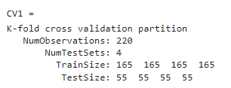
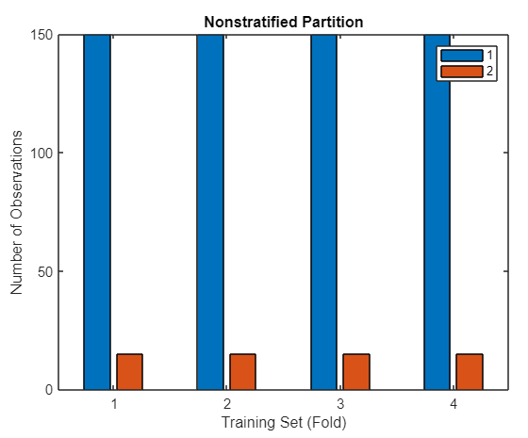
K-fold cross validation
% Generating labels
y = [ones(200,1); 2*ones(20,1)]; % the first 200 belongs to class "1", the last 20, class "2"
% Using K-fold CV (stratified)
CV1 = cvpartition(y,'KFold', 4,'Stratify',true)
Related functions:
cvpartition
Partition visualization
See live script

Slide 6
Leave-one-out cross-validation
Leave-one-out CV as an extreme case of k-fold CV (k = #samples)
Train
Test
. . .
The k samples in dataset are all divided into individuals.
The model is trained on a combination of these (k-1) samples and tested on the remaining one sample.
Cycling through each sample as a testing sample.

Slide 7
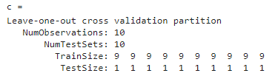
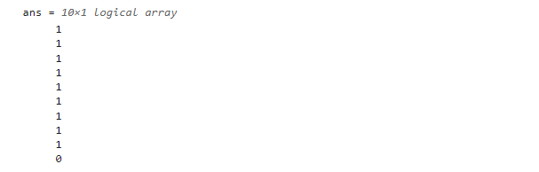
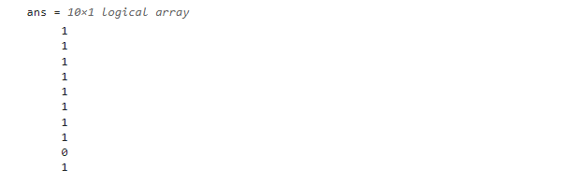
Leave-one-out cross-validation
% Generating dataset
X = [1 2 3 4 5 6 7 8 9 20]';
% Configuring leave-one-out CV
c = cvpartition(10,'Leaveout')
% The first training - excluding the last sample to form testing set
c.training(1)
% The second training - excluding the 9-th sample to form testing set
c.training(2)
See live script

Slide 8




Thanks!
#UofGWorldChangers
@UofGlasgow

